Slide 1
Unsupervised Machine Learning
SL models are trained using labeled data under the supervision of training data.
But, cases no labeled data and need to find the hidden patterns from the given dataset. So, to solve such types of cases, we need unsupervised learning techniques.
US models itself find the hidden patterns and insights from the given data.
US is a type of machine learning in which models are trained using unlabeled dataset and are allowed to act on that data without any supervision.
US cannot be directly applied to a regression or classification problem.

Slide 2
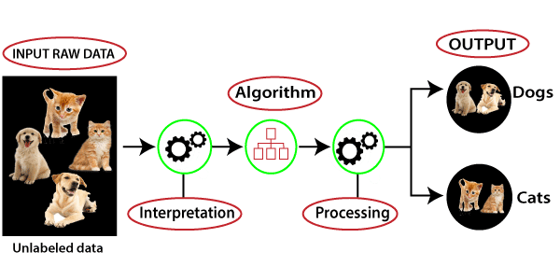
Working of Unsupervised Learning
US is much similar as a human learns to think by their own experiences, which makes it closer to the real AI.

Slide 3
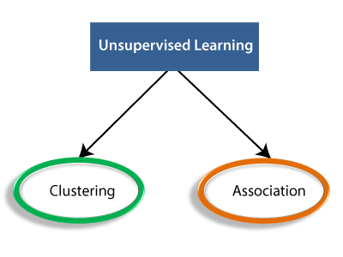
Types of Unsupervised Learning Algorithm
Once it applies the suitable algorithm, the algorithm divides the data objects into groups according to the similarities and difference between the objects.

Slide 4
ເຕັກນິກການແບ່ງຂໍ້ມູນ Train ແລະTest
Data Prepossessing
  Missing values
  Dummy variables

Slide 5
Clustering
Clustering is a method of grouping the objects into clusters, most similarities or no similarities.
Cluster analysis finds the commonalities between the data objects and categorizes them as per the presence and absence of those commonalities.

Slide 6
Association
An association rule is an unsupervised learning method which is used for finding the relationships between variables in the large database.
It determines the set of items that occurs together in the dataset.
Association rule makes marketing strategy more effective.
  Such as people who buy X item (suppose a bread) are also tend to purchase Y (Butter/Jam) item. A typical example of Association rule is Market Basket Analysis.

Slide 7
Popular Unsupervised Learning Algorithms:
K-means clustering
KNN (k-nearest neighbors)
Hierarchal clustering
Anomaly detection
Neural Networks
Principle Component Analysis
Independent Component Analysis
Apriori algorithm
Singular value decomposition

Slide 8
Advantages of Unsupervised Learning
US is used for more complex tasks as compared to supervised learning because, in unsupervised learning, we don't have labeled input data.
US is preferable as it is easy to get unlabeled data in comparison to labeled data.

Slide 9
Disadvantages of Unsupervised Learning
US is intrinsically more difficult than SL as it does not have corresponding output.
The result of the US algorithm might be less accurate as input data is not labeled, and algorithms do not know the exact output in advance.

